Slide 1
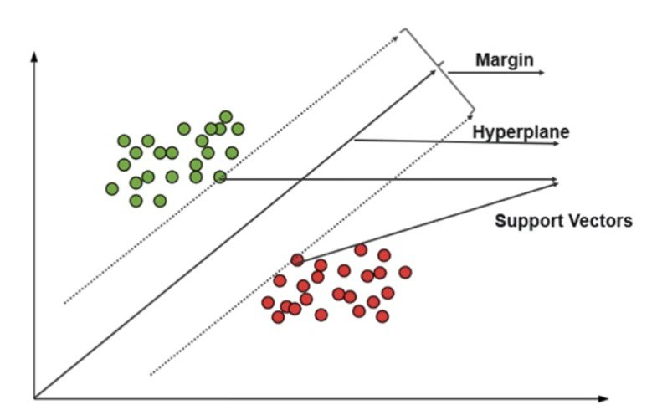
Support vector machines (SVMs)

Slide 2
Agenda
1
2
3
4
5
Introduction
Basic Code Example
Applications &Detailed Application Examples
Pros &Cons of SVM
Why SVM is Supervised Learning?
Summary
What is SVM?
The Idea Behind SVM

Slide 3
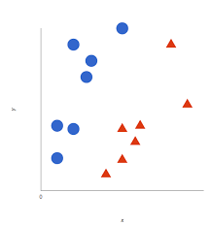

Introduction
Support Vector Machines (SVM) is a supervised machine learning algorithm used for classification and regression tasks. It works by finding the optimal hyperplane that separates different classes or predicts continuous values.
- SVM is significant in machine learning and pattern recognition because it can effectively handle both linearly and non-linearly separable data. It aims to maximize the margin between classes, leading to better generalization and robustness against overfitting.
-SVM has applications in various domains, including:
Text and document classification: SVM can classify documents into different categories based on their content.
Image recognition and computer vision: SVM can be used for object recognition, face detection, and image classification tasks.
Bioinformatics and genomics: SVM can analyze biological data, such as DNA sequences, and predict protein structures or classify genes.

Slide 4
What is SVM?
Support Vector Machines (SVM) is a machine learning algorithm that aims to find the optimal hyperplane to separate classes or predict continuous values in supervised learning tasks.
SVM's purpose is to classify data points by finding the best decision boundary that maximizes the margin between classes. It fits into the broader field of machine learning as a powerful tool for classification and regression, capable of handling both linearly and non-linearly separable data. SVM has strong theoretical foundations and is known for its ability to generalize well and handle high-dimensional data effectively.

Slide 5
Phases of SVM
1- Data Preprocessing: In this phase, the data is prepared for SVM by performing feature scaling, which ensures that all features are on a similar scale. Additionally, the data may be partitioned into training and testing sets to evaluate the model's performance.
2- Model Training: In this phase, the SVM model is trained by optimizing the hyperplane that best separates the different classes or predicts continuous values. The optimization involves finding the support vectors, which are the data points closest to the decision boundary.
3- Model Evaluation: Once the model is trained, it is evaluated in the classification or regression task. For classification, the model assigns class labels to new data points based on their position relative to the decision boundary. For regression, the model predicts continuous values. The evaluation involves assessing metrics such as accuracy, precision, recall, or mean squared error to measure the model's performance.

Slide 6
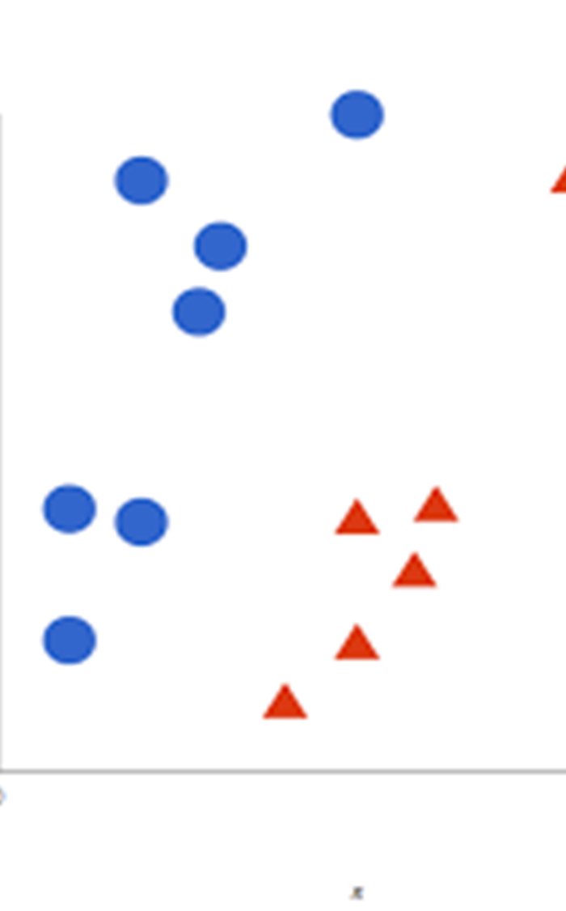
The Idea Behind SVM
The core idea behind SVM is to find the decision boundary that maximizes the margin between different classes. The margin represents the distance between the decision boundary and the closest data points of each class.
By maximizing the margin, SVM aims to achieve better generalization and robustness against overfitting. It helps in classifying new data points accurately because the larger the margin, the more confident we can be about the classification.
The concept of maximum margin allows SVM to focus on the most informative data points, known as support vectors, which are crucial for determining the decision boundary and making accurate predictions.

Slide 7
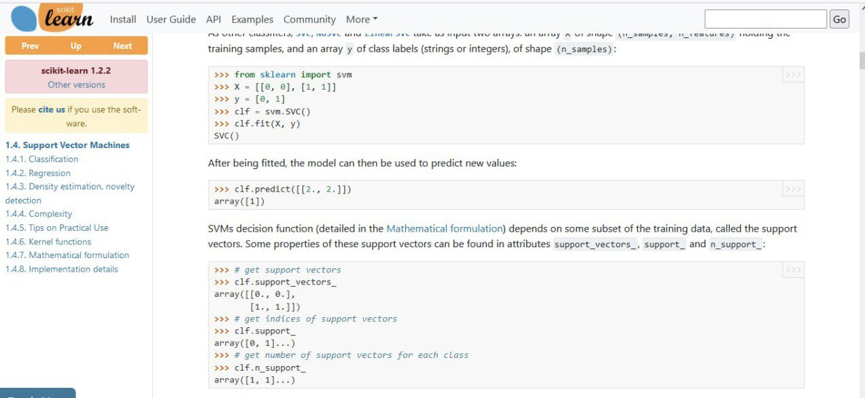
Basic Code Example
CLASSIFICATION CODE :

Slide 8
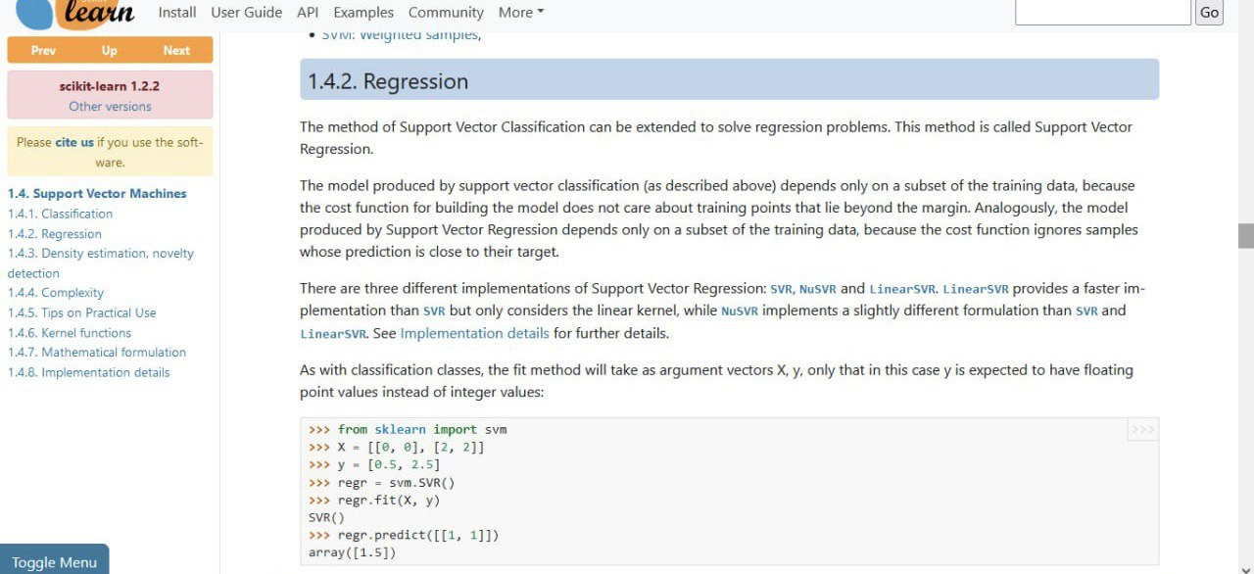
Basic Code Example
REGRESSION CODE :

Slide 9
Why SVM is Supervised Learning?
SVM is a supervised learning algorithm, meaning it requires labeled training data where each data point is associated with a known class label or target value.
Labeled training data is essential for SVM as it provides the algorithm with the ground truth information needed to learn and build the classification or regression model. It allows SVM to understand the relationship between the input features and the corresponding output labels or values. Having labeled examples enables SVM to make predictions on unseen data by generalizing from the patterns learned during training.

Slide 10
Pros &Cons of SVM
advantages of using SVM:
Effective in high-dimensional spaces.
Works well with both linearly and non-linearly separable data.
Robust against overfitting.
the limitations of SVM:
Computationally expensive for large datasets.
Difficult to interpret the model results.
Sensitivity to parameter tuning.

Slide 11
Applications of SVM
the diverse range of applications where SVM is used effectively:
Text and document classification.
Image recognition and computer vision.
Bioinformatics and genomics.
Financial analysis and stock market prediction.

Slide 12
Detailed Application Examples
Real-world applications of SVM cover various domains and include:
Text and document classification: SVM can categorize documents into different topics or identify spam emails.
Image recognition: SVM can recognize objects, faces, or detect specific features in images.
Bioinformatics and genomics: SVM is used in gene expression analysis, protein structure prediction, and identifying disease biomarkers.
Financial analysis: SVM aids in stock market prediction, credit scoring, and fraud detection.

Slide 13
Detailed Application Examples
Real-world applications of SVM cover various domains and include:
Medical diagnosis: SVM helps diagnose diseases based on patient data or medical images.
Handwriting recognition: SVM can be employed to recognize handwritten characters for optical character recognition (OCR).
Social media sentiment analysis: SVM can analyze social media data to determine sentiment or predict trends.

Slide 14
Detailed Application Examples
Real-world applications of SVM cover various domains and include:
Speech recognition: SVM can be used for speech-to-text conversion and speaker identification.
Face detection and biometrics: SVM plays a role in face detection systems and biometric identification.

Slide 15
Summary and Conclusion
In summary, SVM is a supervised learning algorithm used for classification and regression tasks. It works by finding the optimal hyperplane that separates classes or predicts continuous values.

Slide 16
Summary and Conclusion
The phases of SVM include data preprocessing, model training, and model evaluation.
2- SVM holds great importance in machine learning due to its ability to handle both linearly and non-linearly separable data. It is known for its robustness against overfitting, effectiveness in high-dimensional spaces, and its capability to generalize well. SVM has various applications in domains like text classification, image recognition, bioinformatics, finance, and more.
3- Encourage further exploration and learning by emphasizing that SVM is just one algorithm in the vast field of machine learning. Encourage the audience to delve deeper into SVM's mathematical foundations, explore advanced techniques, and apply SVM to new problems. Highlight the importance of continuous learning and staying updated with the latest developments in the field of SVM and machine learning as a whole.

Slide 17
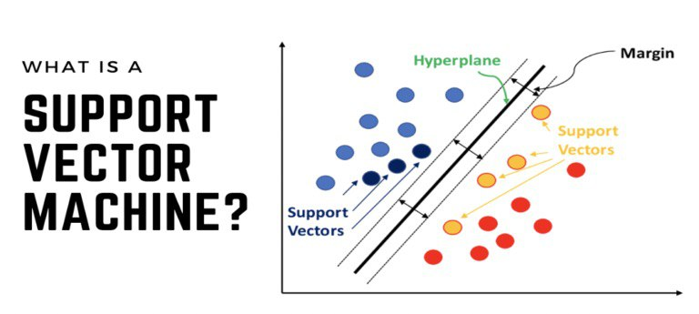
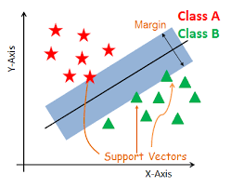
SVM

Slide 18
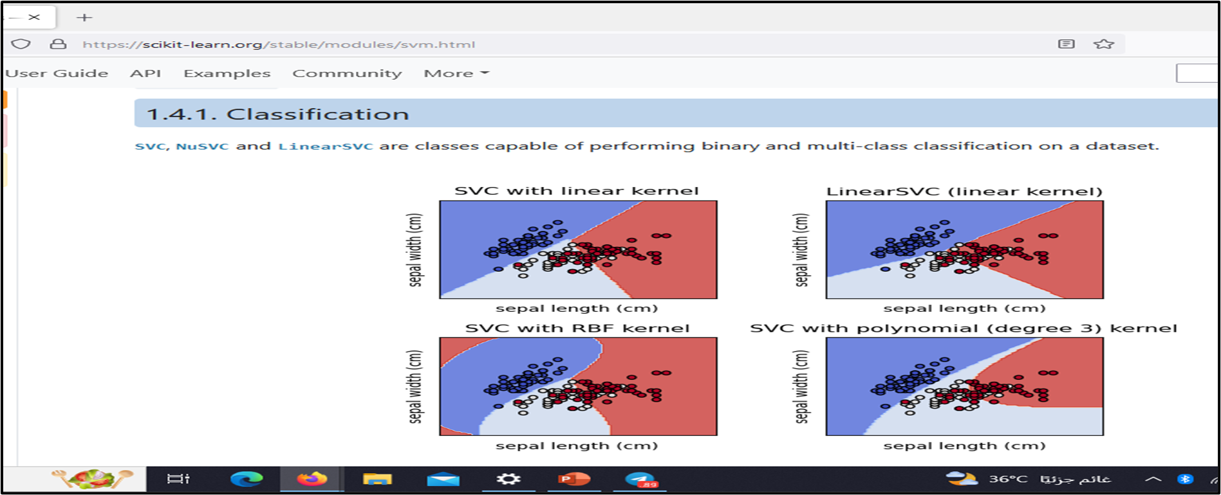
Classification

Slide 19
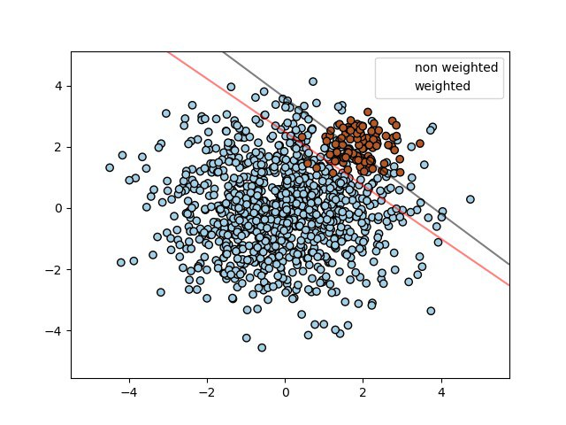
Classification

Slide 20
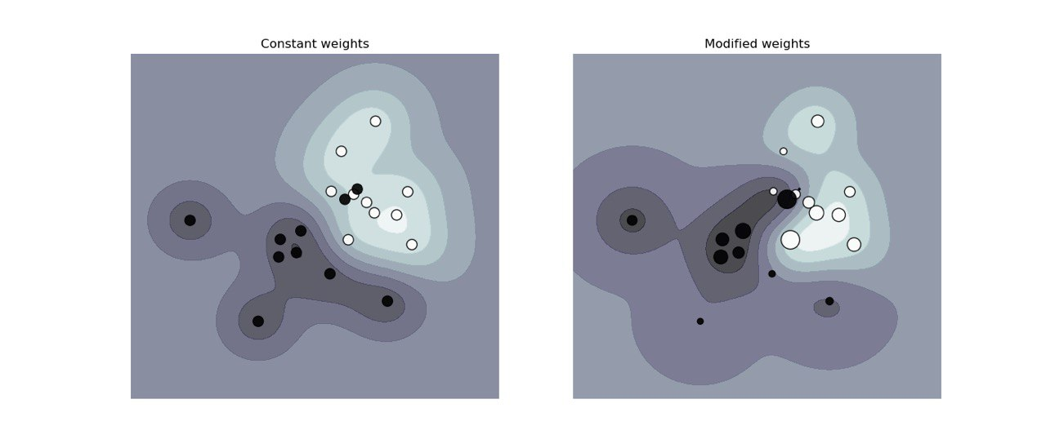
Classification

Slide 21
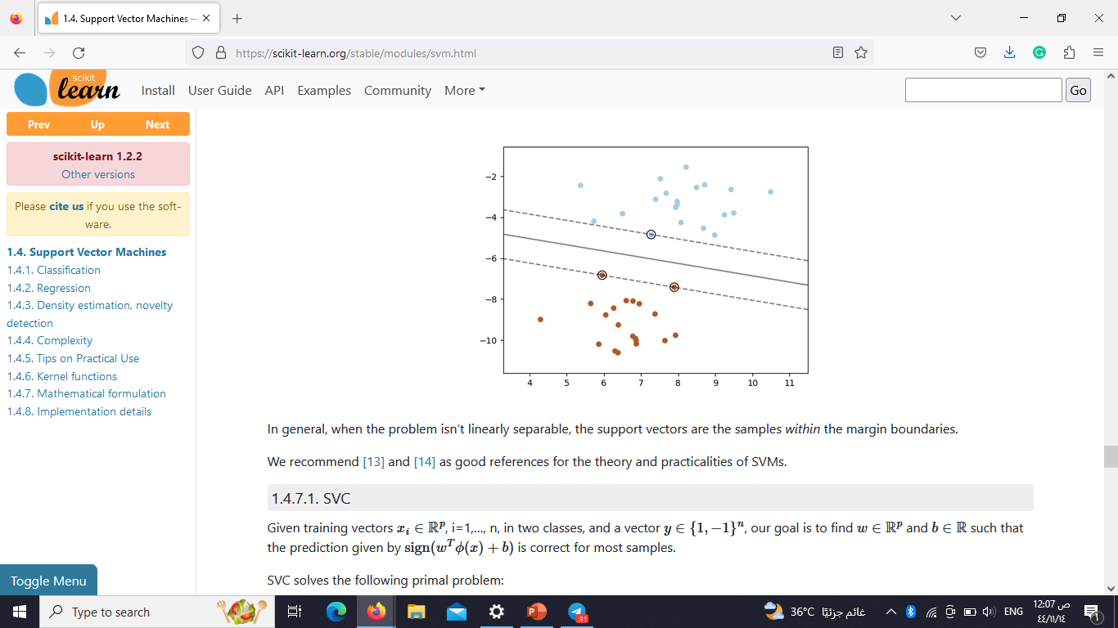
Regression

Slide 22
Thank you

